Slide 1

频率原则实验预备知识
2023年11月9号
Notes:
Thursday, November 9, 2023

Slide 2
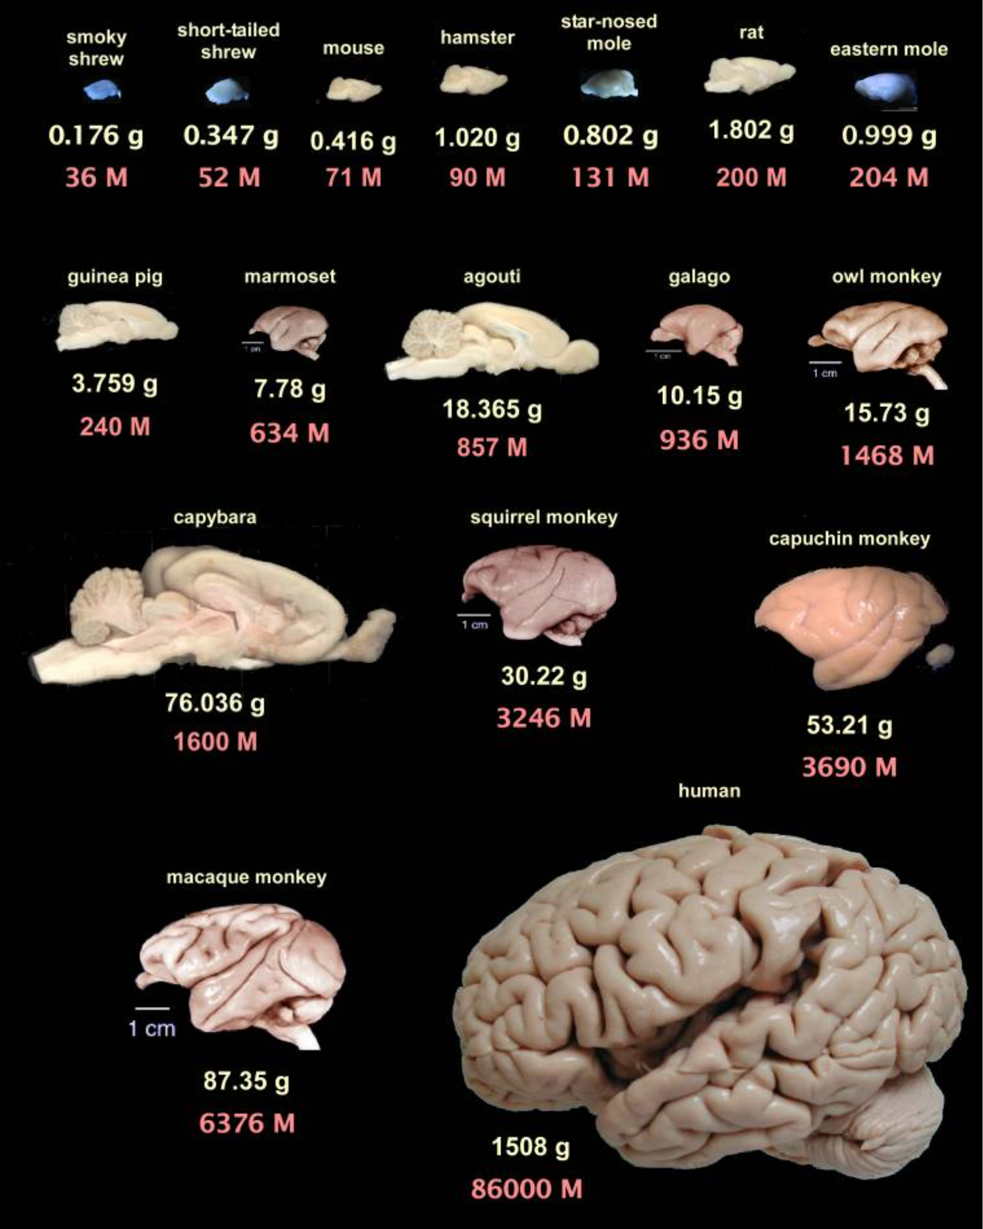
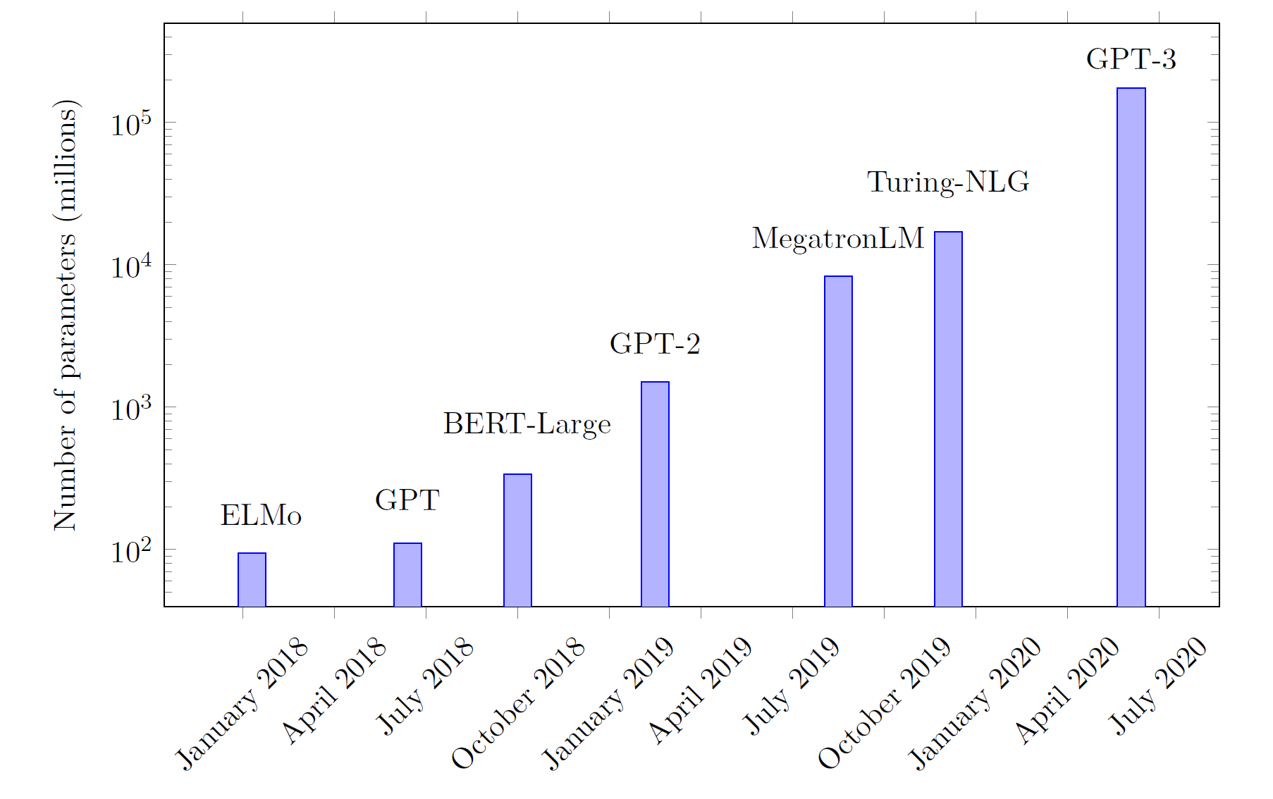
DNN bigger and bigger
Guillaume Hocquet. Class Incremental Continual Learning in Deep Neural Networks. Université Paris-Saclay, 2021
Suzana Herculano-Houzel, 2009

Slide 3
Is NN really so complex?

Slide 4
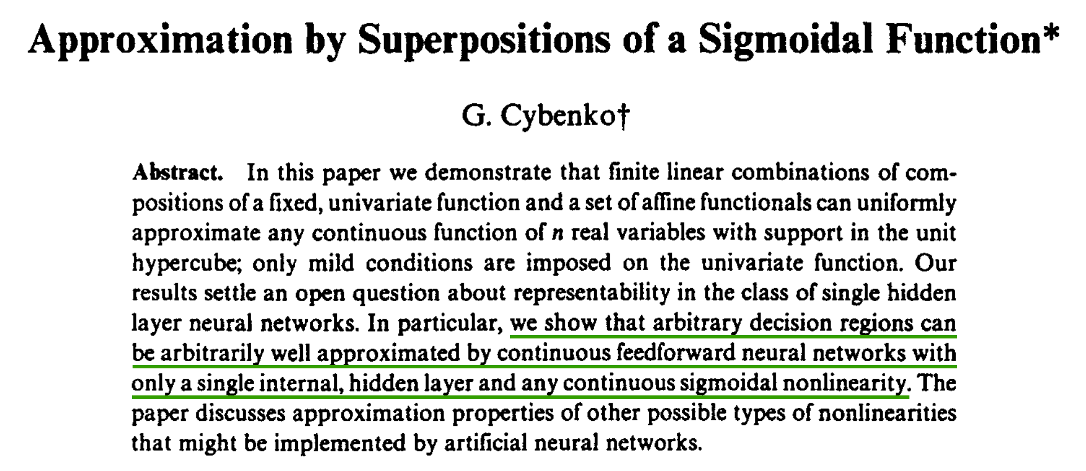
1989
Yes, NN is complex!

Slide 5
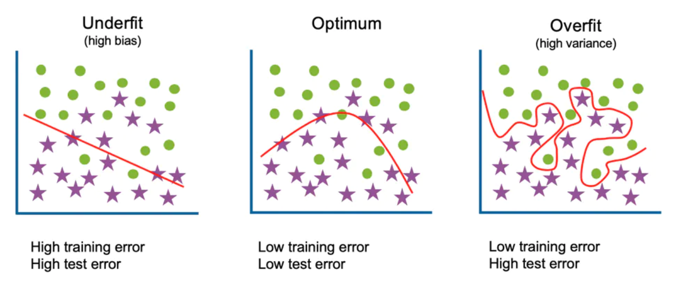
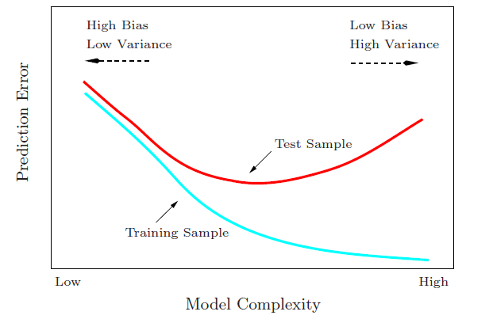
Start from traditional generalization gap
Large complexity → Large generalization gap
Generalization Gap
Traditional wisdom: Too complex is trouble

Slide 6
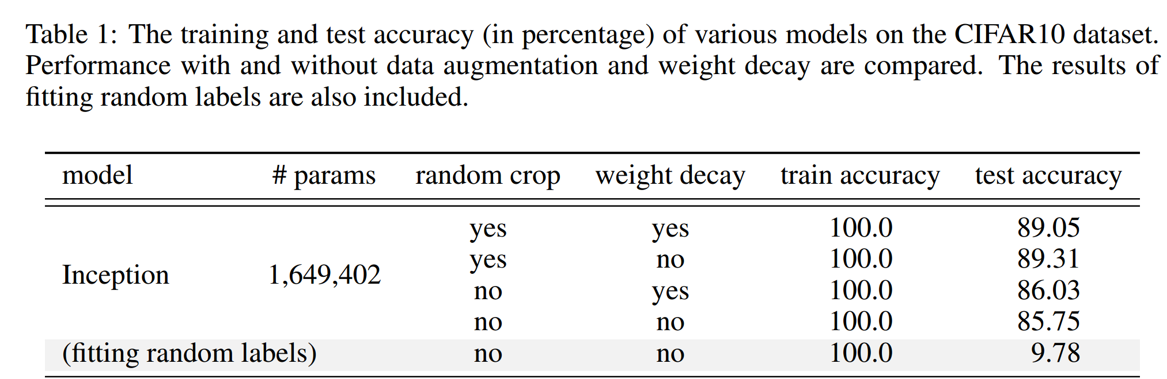
A generalization puzzle arises in deep learning
Puzzle: generalize well even # of para >> # of training data
60000 32x32 colour images in 10 classes
This trouble ignores deep learning?
L. Breiman 1995, Zhang et al., 2016

Slide 7
Is NN really so complex in practice?

Slide 8
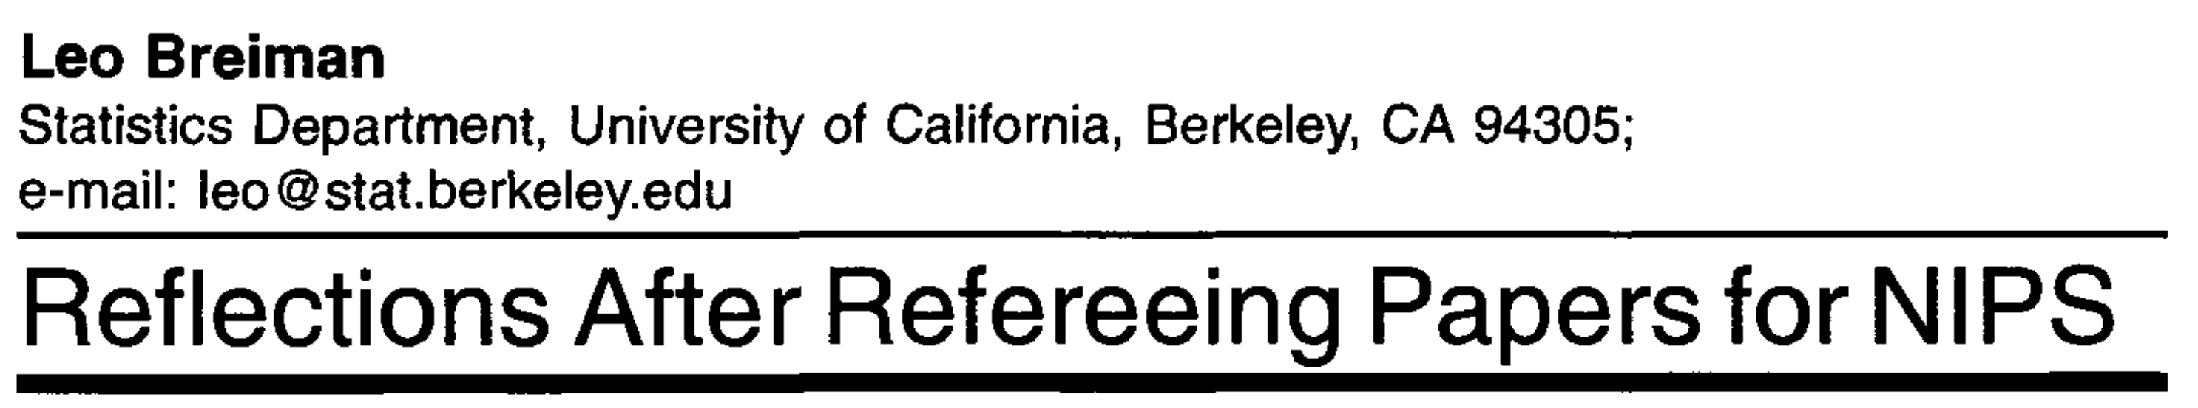
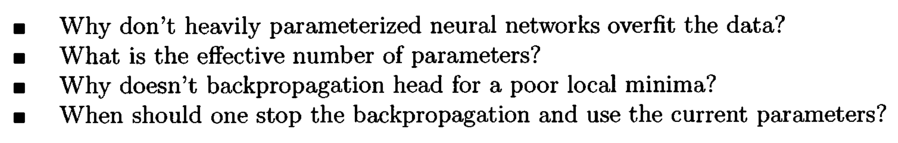
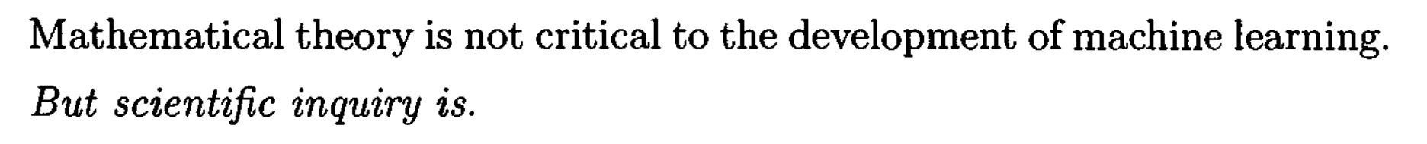
Long-standing problems
1995

Slide 9
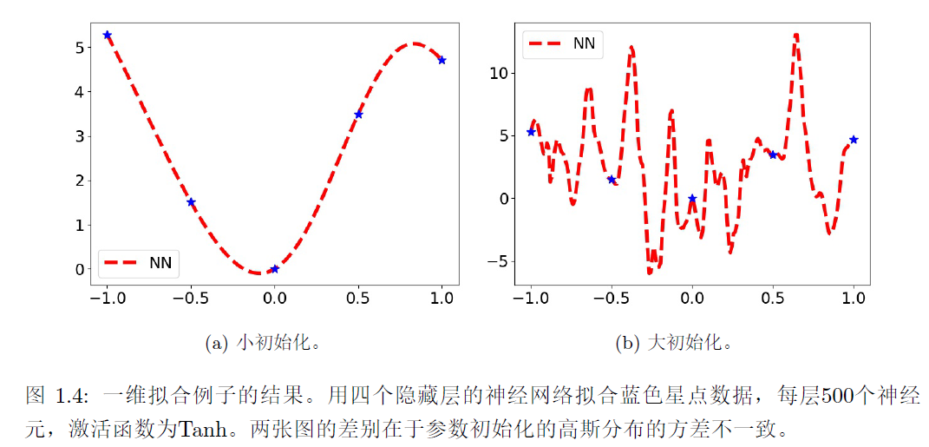
初始化

Slide 10
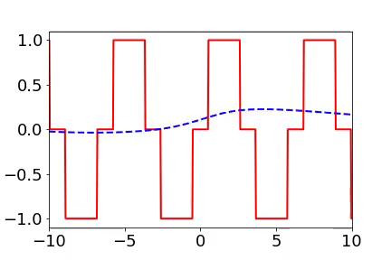
Training process of 1d example in spatial domain
From landscape to detail
Red:
target function
Blue:
DNN fitting
[1] Xu*, Zhang, Xiao, 1807.01251, ICONIP, [2] Xu*, Zhang, Luo, Xiao, Ma, 1901.06523, CiCP

Slide 11
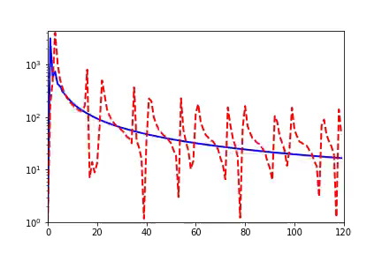
Training process of 1d example in Fourier domain
Frequency principle: From low frequency to high frequency
Red:
target function
Blue:
DNN fitting
Amplitude
Frequency
[1] Xu*, Zhang, Xiao, 1807.01251, ICONIP, [2] Xu*, Zhang, Luo, Xiao, Ma, 1901.06523, CiCP

Slide 12
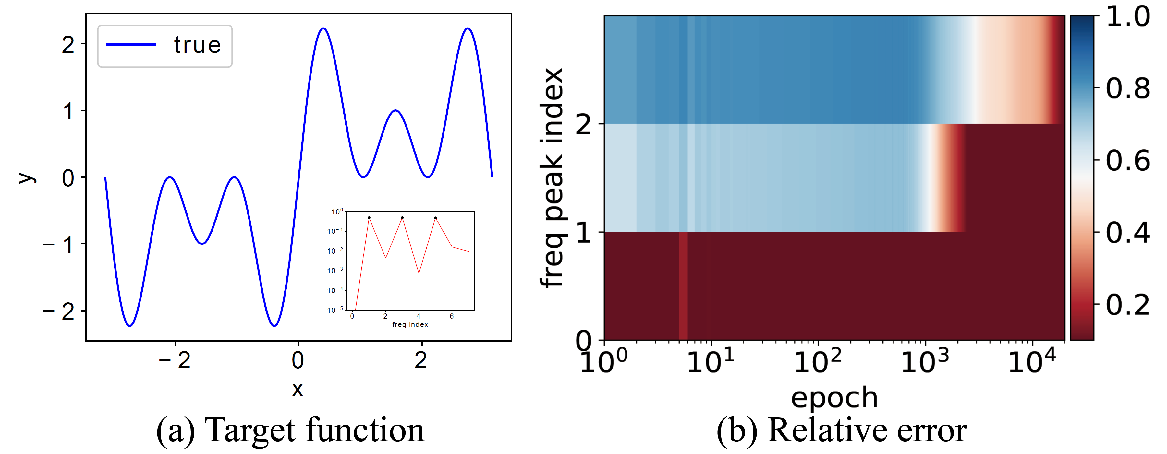
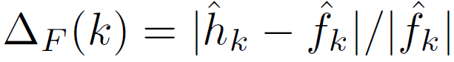
Important problems in this field
Equal amplitudes
$$f\left(x\right)=\sin{x}+\sin{3x}+\sin{5x}$$
1901.06523

Slide 13
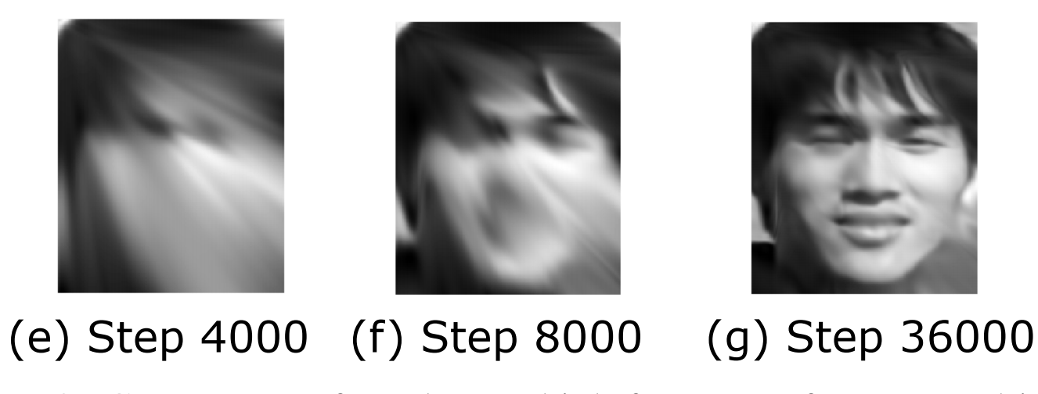
2d data

Slide 14
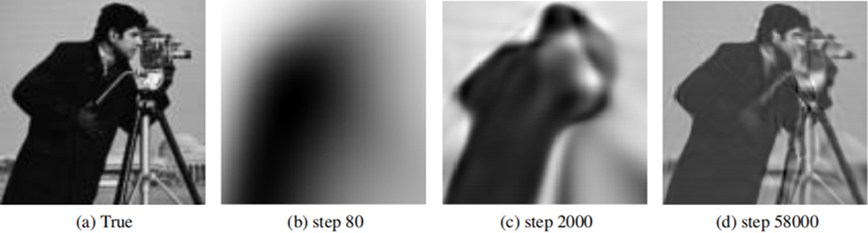
2d data
Xu*, Zhang, Luo, Xiao, Ma, 1901.06523, CiCP

Slide 15

两层神经网络
04

Slide 16
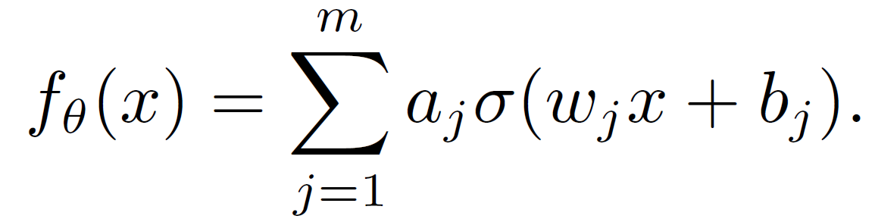
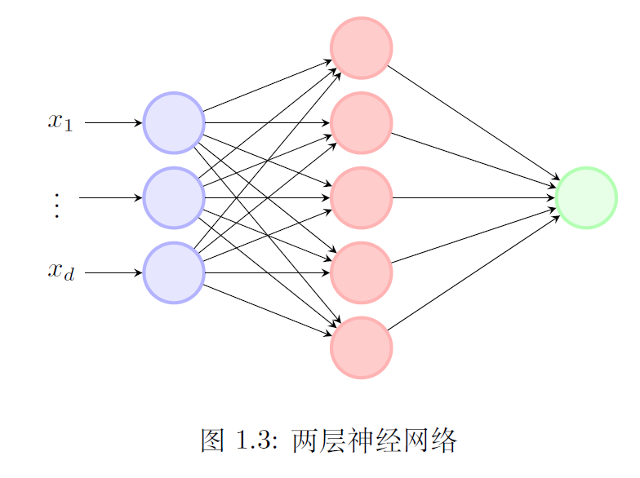
两层神经网络
假设数据集为${\{(x_{i},y_{i})\}}_{i=1}^{n}$，考虑一个只有一层隐藏层的神经网络，即两层神经网络，

Slide 17
向后传播
05

Slide 18
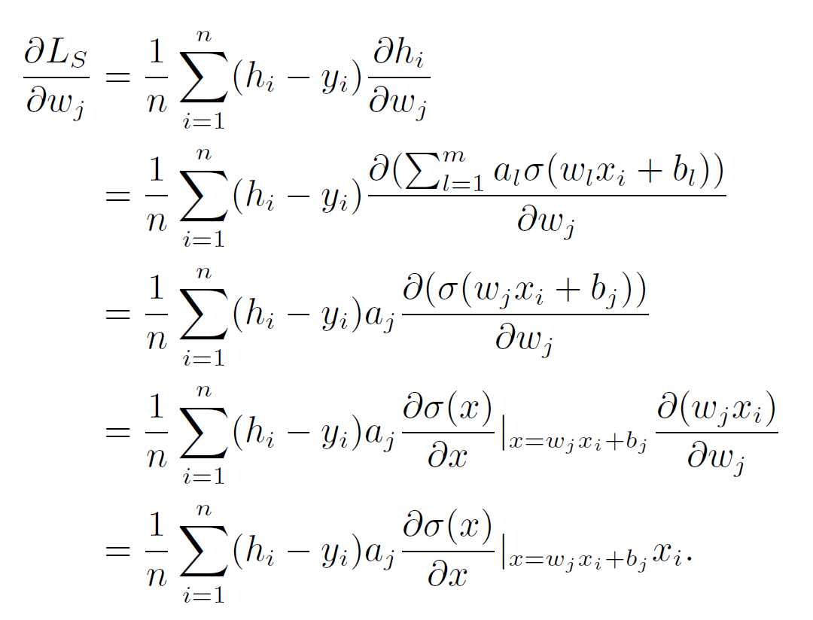
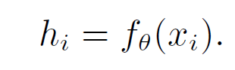
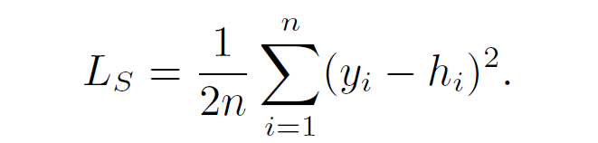
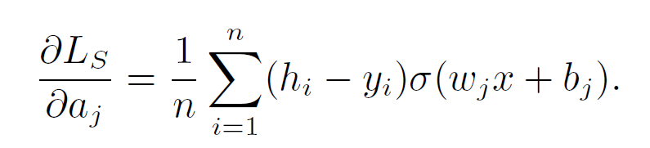
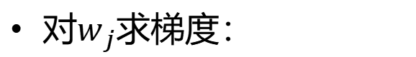
向后传播方法：两层神经网络
两层神经网络：
对$w_{j}$求梯度：
简记为：
均方差损失函数：
对$w_{j}$求梯度：

Slide 19
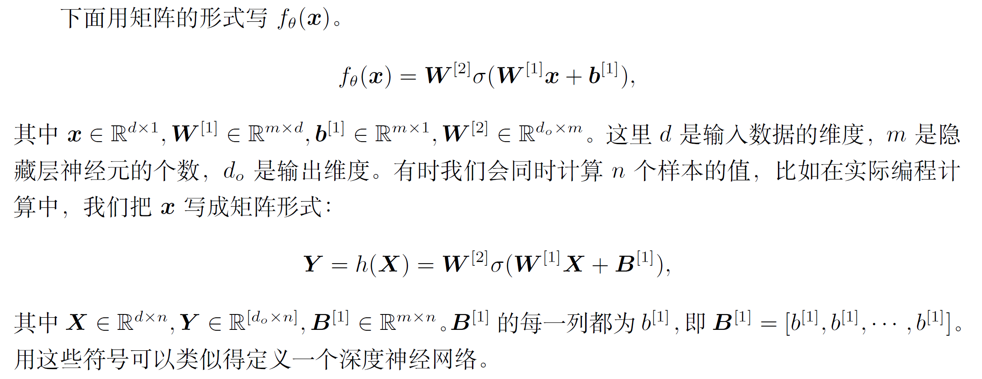
向后传播：矩阵形式

Slide 20
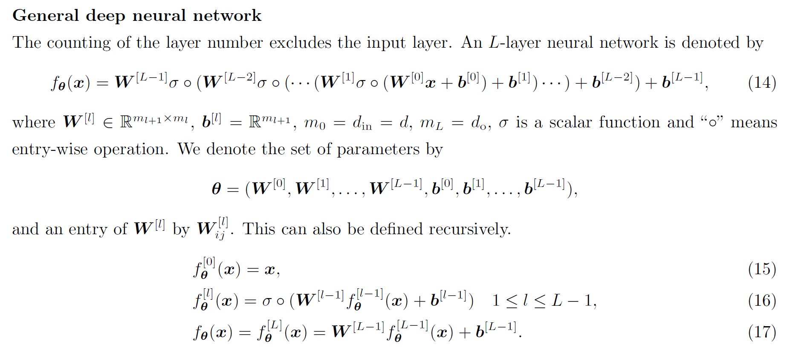
一般神经网络：

Slide 21
实验目的
实验目的
重现频率原则的一维实验
探索哪些因素可以影响频率原则
频率大小
高频的幅度
参考文献
https://github.com/xuzhiqin1990/dnn_simple_experiments
https://github.com/xuzhiqin1990/understanding_dl
[1] Zhi-Qin John Xu* , Yaoyu Zhang, and Yanyang Xiao, Training behavior of deep neural network in frequency domain, arXiv preprint: 1807.01251, (2018), 26th International Conference on Neural Information Processing (ICONIP 2019).
[2] Zhi-Qin John Xu* , Yaoyu Zhang, Tao Luo, Yanyang Xiao, Zheng Ma, Frequency Principle: Fourier Analysis Sheds Light on Deep Neural Networks, arXiv preprint: 1901.06523, Communications in Computational Physics (CiCP).
[3] Zhi-Qin John Xu*, Yaoyu Zhang, Tao Luo, Overview frequency principle/spectral bias in deep learning. arxiv 2201.07395 (2022) .
Zhongwang Zhang : 0123zzw666@sjtu.edu.cn

